Slide 1
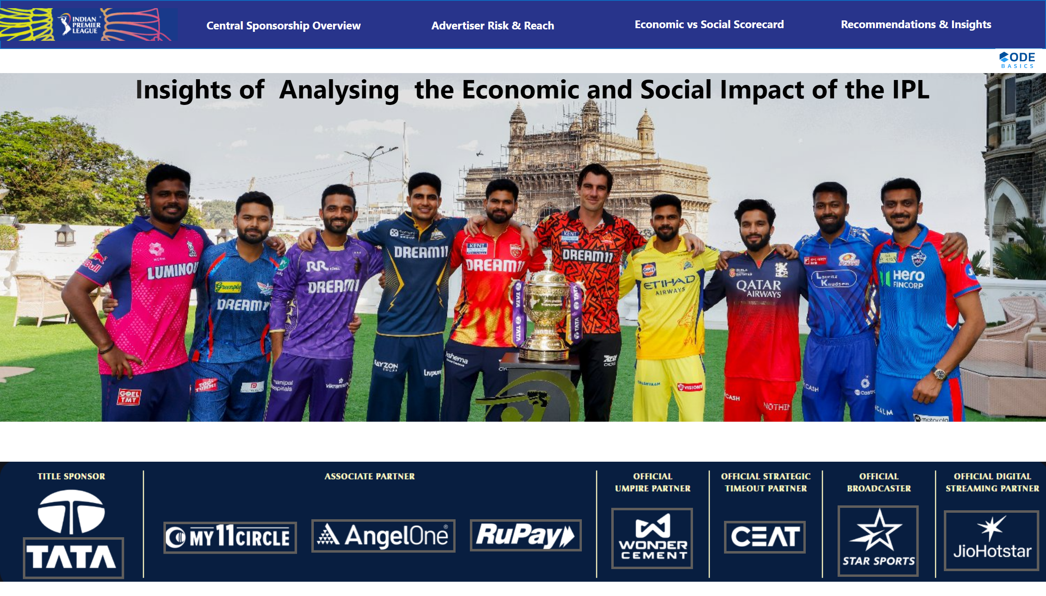
Reference
Notes:
image
No alt text provided
image
No alt text provided
actionButton
No alt text provided
actionButton
No alt text provided
actionButton
No alt text provided
actionButton
No alt text provided
actionButton
No alt text provided
actionButton
No alt text provided
actionButton
No alt text provided
shape
No alt text provided
actionButton
No alt text provided
image
No alt text provided
actionButton
No alt text provided
actionButton
No alt text provided
actionButton
No alt text provided
actionButton
No alt text provided
textbox
No alt text provided
image
No alt text provided

Slide 2
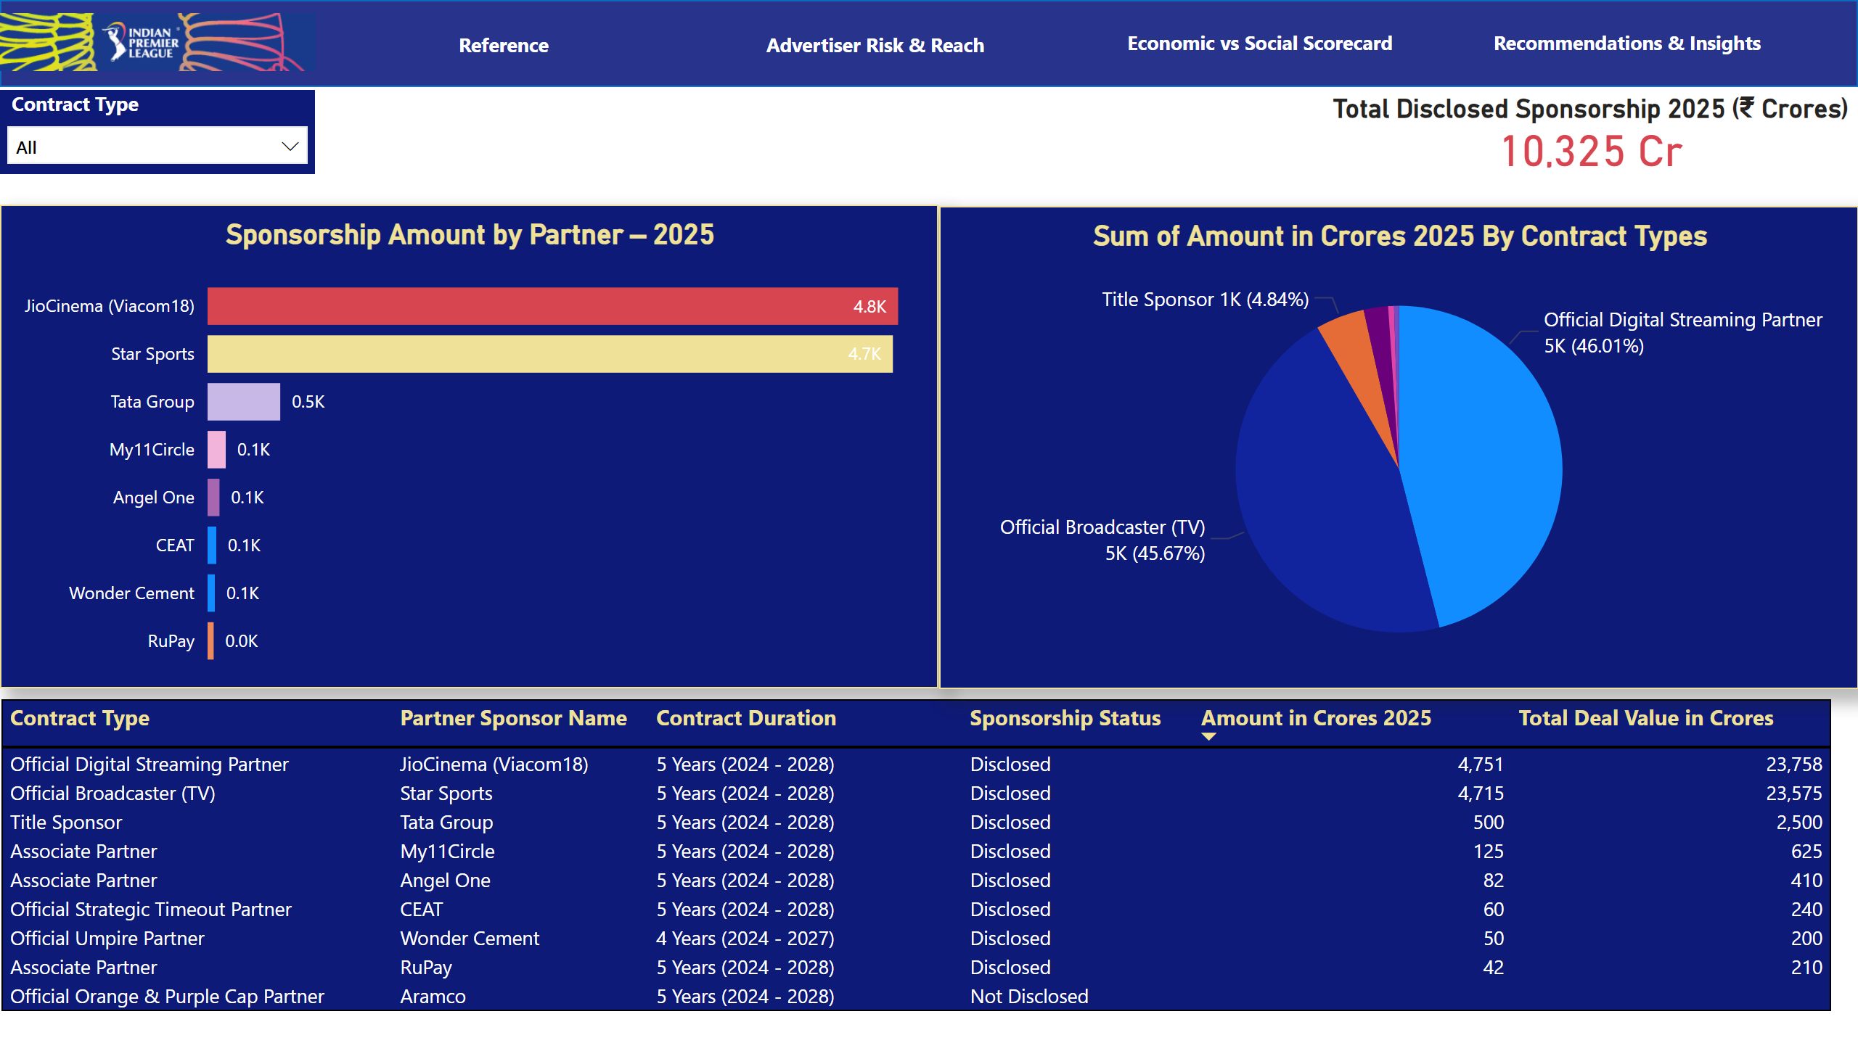
Central Sponsorship Overview
Notes:
Sponsorship Amount by Partner – 2025
No alt text provided
Total Disclosed Sponsorship 2025 (₹ Crores)
No alt text provided
IPL 2025 Sponsorship Details by Partner and Contract Type
No alt text provided
Sum of Amount in Crores 2025 By Contract Types
No alt text provided
slicer
No alt text provided
shape
No alt text provided
image
No alt text provided
actionButton
No alt text provided
actionButton
No alt text provided
actionButton
No alt text provided
actionButton
No alt text provided

Slide 3
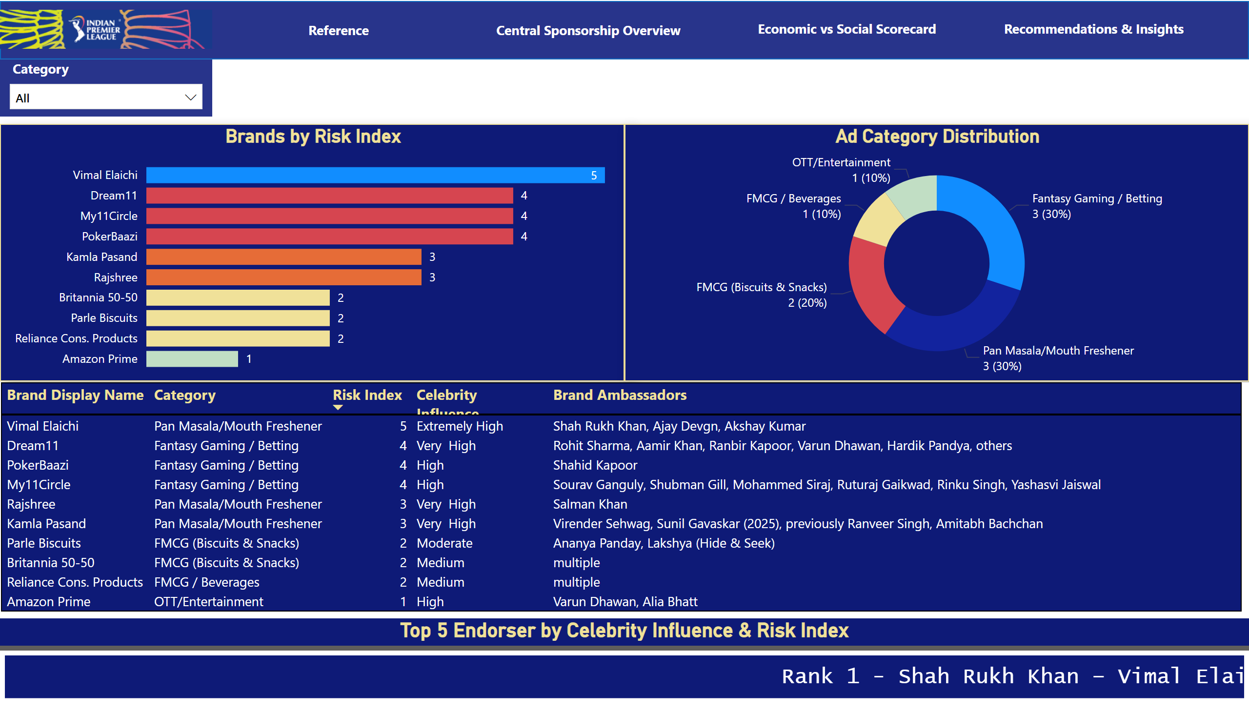
Advertiser Risk & Reach
Notes:
image
No alt text provided
shape
No alt text provided
Brands by Risk Index
No alt text provided
Ad Category Distribution
No alt text provided
tableEx
No alt text provided
slicer
No alt text provided
actionButton
No alt text provided
actionButton
No alt text provided
actionButton
No alt text provided
actionButton
No alt text provided
Top 5 Endorser by Celebrity Influence & Risk Index
No alt text provided

Slide 4
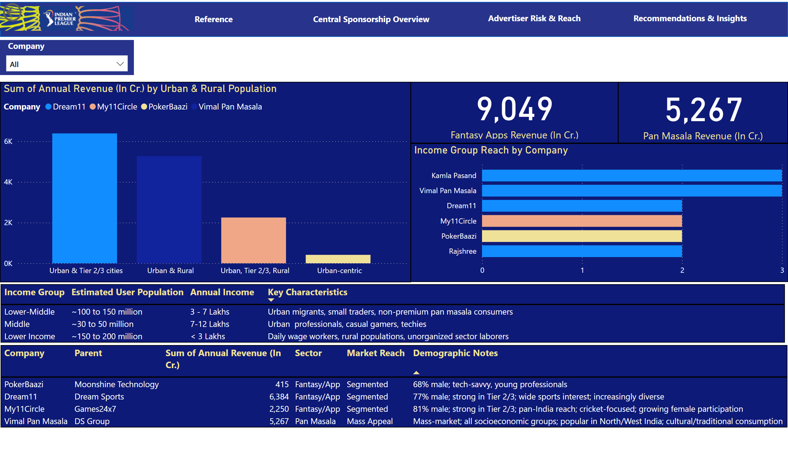
Economic vs Social Scorecard
Notes:
image
No alt text provided
actionButton
No alt text provided
actionButton
No alt text provided
actionButton
No alt text provided
shape
No alt text provided
Sum of Annual Revenue (In Cr.) by Urban & Rural Population
No alt text provided
card
No alt text provided
card
No alt text provided
actionButton
No alt text provided
slicer
No alt text provided
tableEx
No alt text provided
tableEx
No alt text provided
actionButton
No alt text provided
clusteredBarChart
No alt text provided

Slide 5
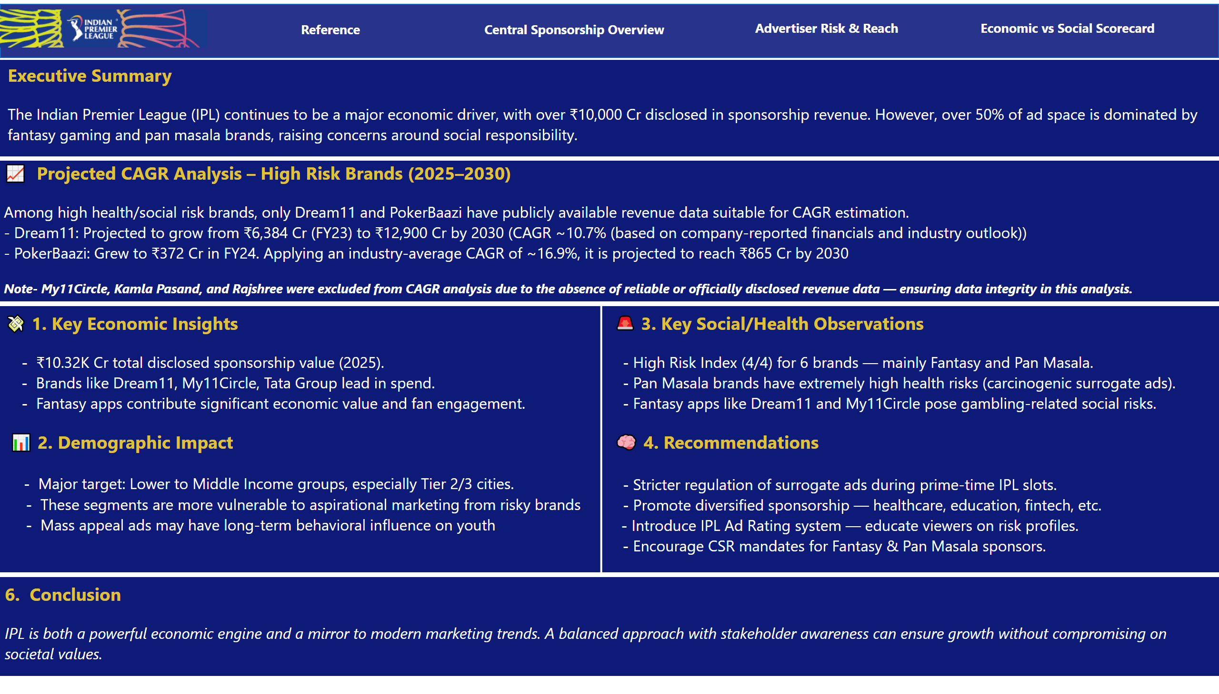
Recommendations & Insights
Notes:
image
No alt text provided
textbox
No alt text provided
textbox
No alt text provided
textbox
No alt text provided
textbox
No alt text provided
actionButton
No alt text provided
actionButton
No alt text provided
actionButton
No alt text provided
actionButton
No alt text provided
textbox
No alt text provided
shape
No alt text provided
shape
No alt text provided

